Slide 1
L05.02 Hashing II
50.004 Introduction to Algorithm
Dr. Simon LUI
ISTD, SUTD

Slide 2
Objective
Open addressing: how to implement hashing without chaining
Table doubling: amortized cost of operations

Slide 3
Open addressing
Idea: instead of following pointers, follow a sequence of slots to be examined (we call it probing)
All elements are contained in the hash table itself, no pointers to lists outside the table
Need to examine only table slots, no external linked list
Table can fill up, so we need α <1

Slide 4
Open addressing algorithms
Linear probing
Quadratic probing
Double hashing

Slide 5
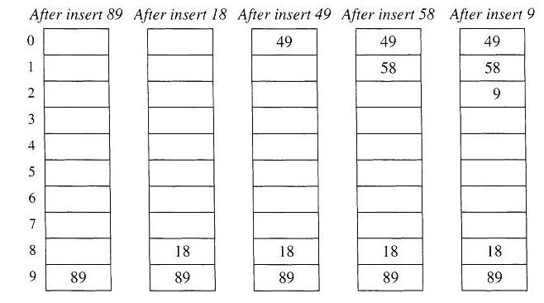
Example – linear probing
h(k,i) = (h’(k)+i) mod 10
h’(k) = k mod 10

Slide 6
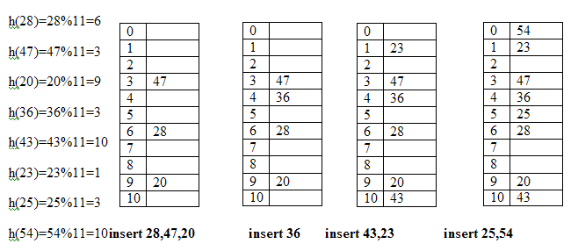
Example – linear probing
h(k,i) = (h’(k)+i) mod 11
H’(k) = k mod 11

Slide 7
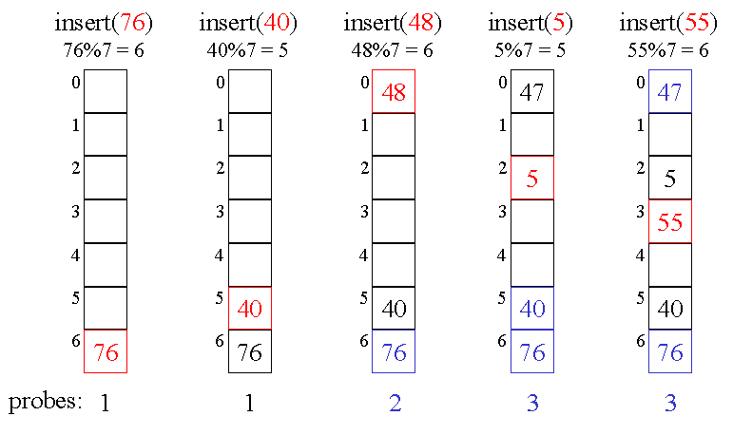
Example – quadratic probing
h(k,i) = (h’(k)+c₁i + c₂i²) mod 7 c₁=0 , c₂=1
H’(k) = k mod 11

Slide 8
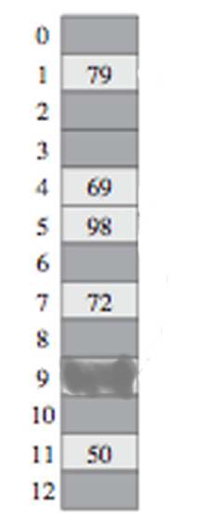
Questions
A. Linear probing
Consider the hash table in the picture with some keys already inserted. Where will you insert k=17 when h’(k) = k mod 13?
location 2
location 6
location 10
B. Quadratic probing
Where will you insert k=17 when h’(k) = k mod 13,
c1 =2, c2 =1?
location 2
location 7
location 12
C. Double hashing
Where will you insert k=14 when h1(k) = k mod 13,
h2(k) = 1+(k mod 11)?
location 2
location 9
location 10

Slide 9
Cuckoo Hashing
Uses 2 hash functions
Key k stored either in
Lookup: Just look at at most 2 places!
Insertion:
If empty, store the key there
else if empty, store the key there
If both full, store key in and move key that was there to its other location
(bumping out the key that might be there, etc)
If α<1 insertion succeeds with high probability
If insertion loops: rehash the entire table (or double table size)
Insertion takes constant time on average
O(1)

Slide 10
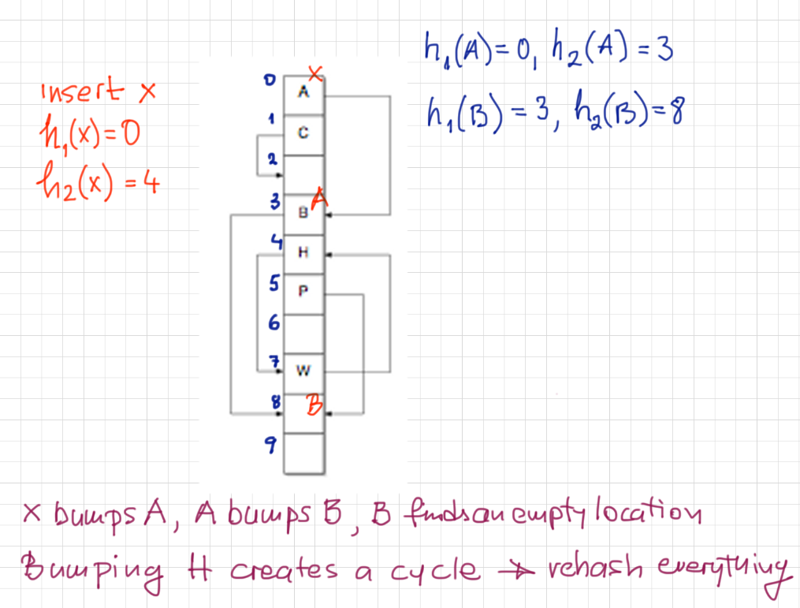
Example of cuckoo hashing
Cuckoo hashing

Slide 11
Why we need table doubling
A good table should be:
Make the table as small as possible
Large enough so that it won’t overflow
Table doubling: only expand the table when we need

Slide 12
Table doubling
Suppose we start with an empty hash table and keep inserting keys
Load factor increases and eventually α=1
Solution: when α=1:
- allocate new table 2x the size
- rehash all elements into new table
Now α=0.5!
Equivalently: double hash table when n=2,4,8,…
When I double the hash table -> cost Θ(m)
What is the average cost per insert operation = amortized cost

Slide 13
Table doubling and amortized costs
table doubling sizes
m = 4
m = 8
m = 16
m = 32
2
4
8
16
insertions
Cost of table doubling
Cost of insertions
Amortized cost of insertions

Slide 14
Out of syllabus: rolling hash

Slide 15
Rolling Hash
Great application for pattern matching problems
Uses hashing in a clever way, but no hash tables
Problem: Find occurrences of “imagine” in a large text
Text = array T[1..n] = “Imagine, It is hard for me to imagine anything”
Pattern = array P[1..m] = “imagine”
Return all positions s such that T[s+1..s+m] = P[1..m],
m
1
s
s’
n
the complexity of the naïve : Θ(nm) (too bad…. Can we do better?)

Slide 16
Rolling Hash: the Rabin-Karp algorithm
At each step:
Use a sliding window of m characters: T[s+1..s+m] is visible
Do a “quick check” (not 100% sure) to see if it is a possible matching
-> compare
Need fast way to update hash value when the window slides
one position to the right T[s+1..s+m] -> T[s+2..s+m+1]
…a h j s h u j k s d j g h l p d p s q j k a s j k j …
slide by one character

Slide 17
Rolling Hash: the Rabin-Karp algorithm
…a h j s h u j k s d j g h l p d p s q j k a s j k j …
slide by one character
Consider the window to contain an m-digit number (in suitable base B)
O(1)
If h[T] = h[P] -> verify match (time m) to exclude a collision (-> prob 1/q)
Time: initial hash + sliding window + handle false positives + handle v valid hits

Slide 18
Conclusions
Open addressing is an efficient method to do hashing
If the number of items is growing, we need to do table doubling; average cost of operations remains Θ(1)
Cuckoo hashing is a smart way to hash so that most operations are done in at most 2 steps
Rolling hash: perform efficient pattern matching in documents

